Slide 1







Skinning
Tips, Tricks, Hacks & How Tos
Lee Wise / Front End Developer
@theleewise

Slide 2
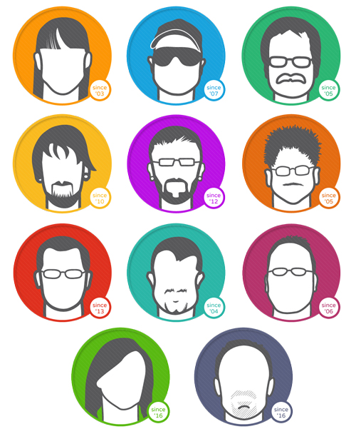
10 Pound Gorilla Team
Everything DNN
Skins
Modules
Development
Consulting
Everything Else
Internet Marketing
Web Development
Graphic Design
SEO
Social Media Marketing
Adwords
Online Marketing
Email Marketing

Slide 3
My Goal
“That’s really stinkin’ cool!”
“No Duh”

Slide 4
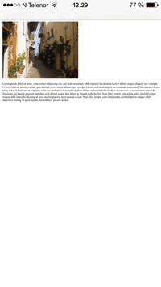
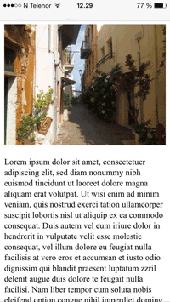
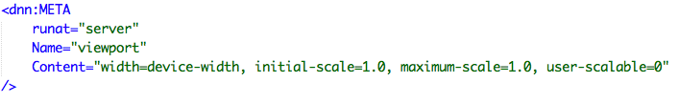
Configure Viewport
Using the meta tag we can set your page to to be displayed properly on mobile devices instead of just be a zoomed out version of your desktop design. By utilizing DNN's "Meta" skin object we can do this right in the skin.

Slide 5
Include Files
You can insert the content of one ASP file into another ASP file before the server executes it, with the #include directive.
The #include directive is used to create functions, headers, footers, or elements that will be reused on multiple pages

Slide 6
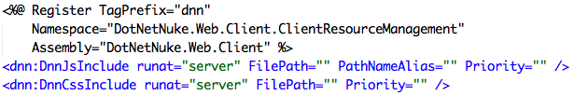
Client Resource Management
This is a skin object that allows you to include JavaScript and CSS files in the head of the document.
A great way to utilize this is with Google fonts.

Slide 7
Multiple Menus
By utilizing the available attributes "ExcludeNodes" & "IncludeNodes" you can create several different menus.
The most common use of this is with the two sets of navigation usually at the top of the page and one being the more prominent and important and the other being a smaller, secondary set of menu items.

Slide 8
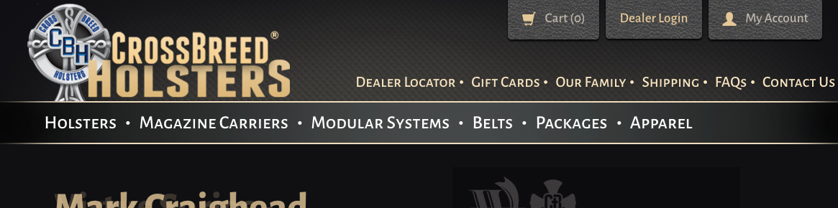
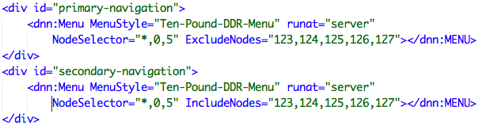
Multiple Menus (Example)

Slide 9
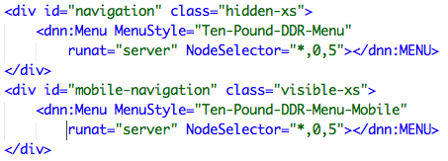
Desktop & Mobile Menus
Output duplicate menus for different viewport sizes.

Slide 10
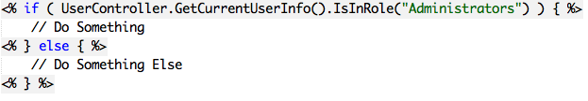
Conditional Content

Slide 11
Dynamic Attributes

Slide 12
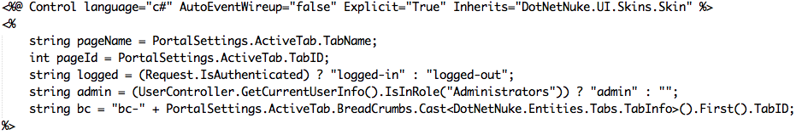
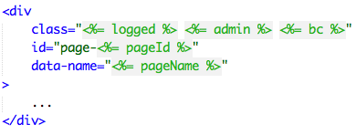
Dynamic Attributes (Code)

Slide 13
DNN Properties In JavaScript
You can add various properties of the site, page, and user to a JavaScript object for client side access to such information like the current page id or the roles of the current user.

Slide 14
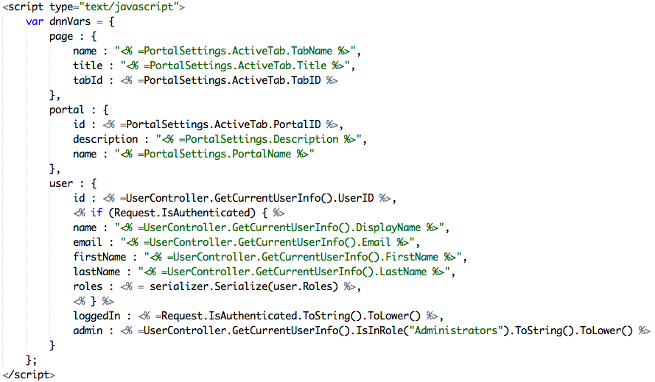
DNN Properties In JavaScript (Code)

Slide 15

Resources
http://boomerangdns.com/Computers/Specifications/DNNDotNetNukeStuff/DotNetNukeModuleTokens.aspx

Slide 16









THANKS TO ALL OF OUR GENEROUS SPONSORS!

